Slide 1
FIT1045 Introduction to Algorithms and Programming Lecture 21 Intractable Problems
Some slides have been updated from Julian Gracia’s lectures
COMMONWEALTH OF AUSTRALIA
Copyright Regulations 1969
WARNING
This material has been reproduced and communicated to you by or on behalf of Monash University pursuant to Part VB of the Copyright Act 1968 (the Act).The material in this communication may be subject to copyright under the Act.Any further reproduction or communication of this material by you may be the subject of copyright protection under the Act.
Do not remove this notice.

Slide 2
Overview
Inefficient Algorithms
Decision Problems
Certificates
NP problems
NP-Completeness
Polynomial reducible

Slide 3
Growth Rates
N | log(N) | N | Nlog(N) | N² | 2^{N} | N!
10 | 0.003 μs | 0.01 μs | 0.033 μs | 0.1 μs | 1 μs | 3.63 ms
20 | 0.004 μs | 0.02 μs | 0.086 μs | 0.4 μs | 1 ms | 77.1 years
30 | 0.005 μs | 0.03 μs | 0.147 μs | 0.9 μs | 1 sec | 8.4x10¹⁵ years
40 | 0.005 μs | 0.04 μs | 0.213 μs | 1.6 μs | 18.3 min
50 | 0.006 μs | 0.05 μs | 0.282 μs | 2.5 μs | 13 days
100 | 0.007 μs | 0.1 μs | 0.644 μs | 10 μs | 4x10¹³ years
1,000 | 0.010 μs | 1 μs | 9.966 μs | 1 ms
10,000 | 0.013 μs | 10 μs | 130 μs | 100 ms
100,000 | 0.017 μs | 100 μs | 1.67 ms | 10 sec
1,000,000 | 0.020 μs | 1 ms | 19.93 ms | 16.7 min
10,000,000 | 0.023 μs | 10 ms | 0.23 sec | 1.16 days
100,000,000 | 0.027 μs | 0.1 sec | 2.66 sec | 115.7 days
1,000,000,000 | 0.030 μs | 1 sec | 29.90 sec | 31.7 years
Measured in nanoseconds (10⁻⁹ secs)
Age of universe ≅ 1.4x10¹⁰ years

Slide 4
Algorithmic Time Complexity
Constant O(1)
Logarithmic O(log N)
Linear O(N)
Superlinear O(N log N)
Quadratic O(N²)
Polynomial O(N^{k})
Polynomial
Exponential O(2^{N})
Factorial O(N^{N})
Inefficient

Slide 5
Inefficient Algorithms
Have at least exponential time complexity.
Algorithms that produce at least an exponential size output.
Hanoi Tower, Generating subsets, Generating Permutations.
Algorithms which have exponential time complexity, but for which exists polynomial time algorithms that solve the same problem.
Computing Fibonacci numbers.
Algorithms for intractable problems. These have no known polynomial time algorithm that solves them.
Traveling Salesman.

Slide 6
Decision Problems
A problem that has only a Yes or a No as the output.

Slide 7
Hamiltonian Cycles
A Hamiltonian cycle for a graph is a path that passes through every vertex exactly once.

Slide 8
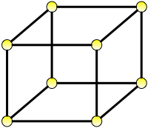
The following graph has a Hamiltonian cycle.
True
False

Slide 9
Hamiltonian Cycle Problem
Given a connected graph G.
Does there exist a Hamiltonian cycle in G?

Slide 10
Traveling Salesman
Suppose you are given the following driving distances in kms between the following capital cities.
Find the shortest route that enables a salesman to start at Canberra, visit all the other cities, before returning to Canberra.
 | Adelaide | Brisbane | Canberra | Darwin | Sydney
Adelaide |  | 2053 | 1155 | 3017 | 1385
Brisbane | 2053 |  | 1080 | 3415 | 939
Canberra | 1155 | 1080 |  | 3940 | 285
Darwin | 3017 | 3415 | 3940 |  | 3975
Sydney | 1385 | 939 | 285 | 3975

Slide 11
Traveling Salesman Decision Problem
Given a connected weighted graph, G, and a number, k.
Does there exist a Hamiltonian cycle in G that has a total weight less than equal to k?

Slide 12
Vertex Cover
A vertex cover, C, is a subset of vertices of a graph, such that every edge in the graph has at least one of its end points in C.

Slide 13
Vertex Cover Problem
Given a graph, G, and an integer k.
Is there a vertex cover of k vertices in G?

Slide 14
There is a vertex cover of size 2 or less for the following graph.
B
D
A
F
C
E
True
False

Slide 15
Clique
Give a graph G.
A clique is a subgraph where there is an edge between every two vertices.

Slide 16
Clique Problem
Give a graph G and an integer k.
Does there exist a clique of k vertices in G?

Slide 17
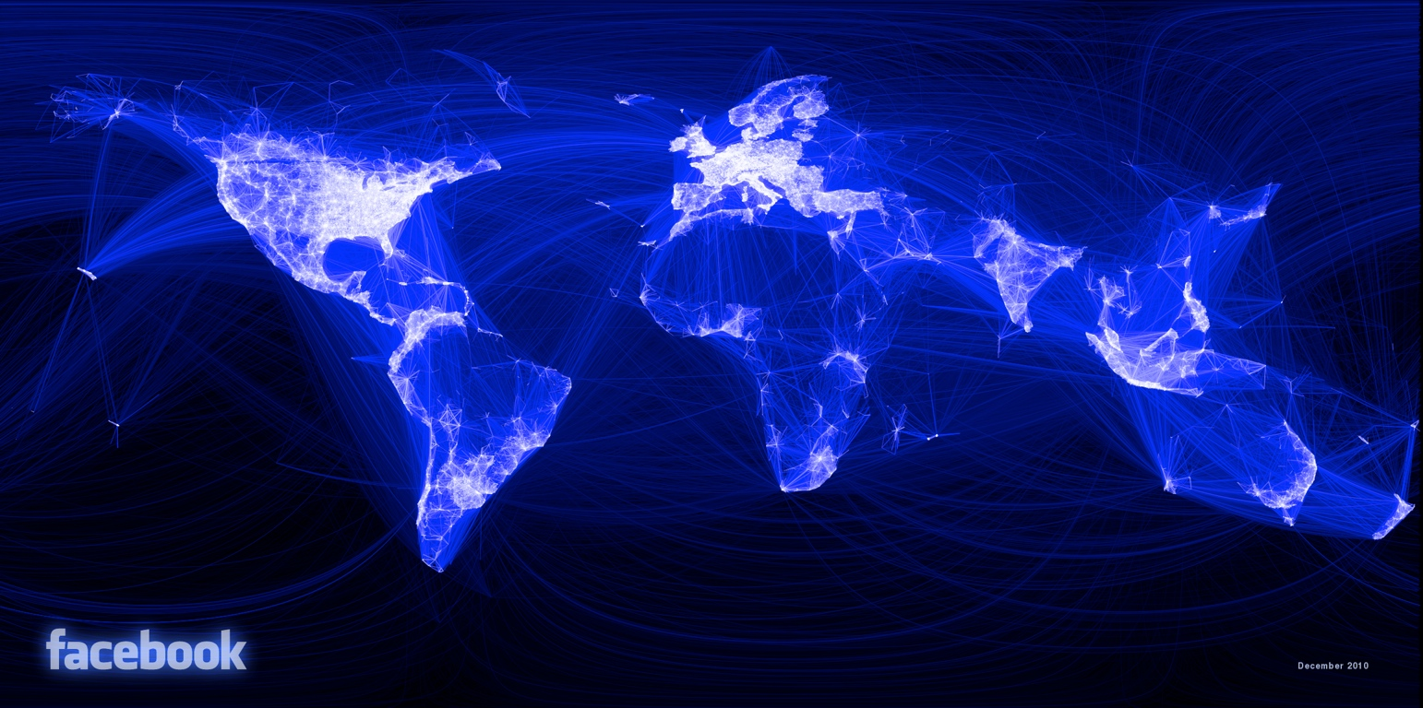
Find the largest clique ...
Visualizing friendship, Graph by Paul Butler.
Source: http://www.facebook.com/notes/facebook-engineering/visualizing-friendships/469716398919

Slide 18
There is a clique of four vertices.
B
D
A
F
C
E
True
False

Slide 19
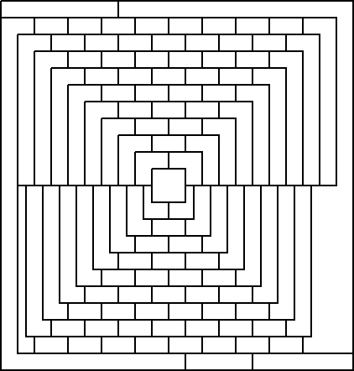
Three-colourable Problem
Given: A map.
Question: Can you colour the map with only 3 colours so that no two regions, that share a border, have the same colour?

Slide 20
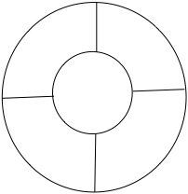
The following 5-region map can be coloured using only 3 colours.
True
False

Slide 21
Decision Problem
Input
Algorithm
Output:
Yes
No

Slide 22
Hamiltonian cycle
Input: Graph G
Question: Does G have a Hamiltonian cycle?
Vertex cover
Input: Graph G and integer k
Question: Does graph G have a vertex cover of size k or less?
Clique
Input: Graph G and integer k
Question: Does graph G have a clique of size k or more?
Map colouring
Input: Map M?
Question: Can map M be coloured using 3 or less colours?

Slide 23
P Class of Problems
P is the class of decision problems that can be solved in polynomial time.
Is a target in a list?
Is the median of the elements in a list > 0
Is this list sorted?

Slide 24
NP Class of Problems
NP is the class of decision problems whose solutions can be verified in polynomial time.
Does graph G have a vertex cover of size k or less?
Does graph G have a clique of size k or more?
Does graph G have a Hamiltonian cycle?
B
B
D
D
Can map M be coloured using 3 or less colours?
A
A
F
F
C
C
E
E
A lot more ...

Slide 25
Certificates
A certificate is a possible solution.
Problem | Certificate
Hamiltonian Cycle | Set of vertices
Vertex Cover | Set of vertices
Clique | Set of vertices
3-colourable | A colouring of the map
Factorisation | Factors
It is often easier to verify a solution than to find it.

Slide 26
How to show that a decision problem is in NP?
Show that we can verify the solution in polynomial time.

Slide 27
P⊆NP
Every problem that can be solved in Polynomial time can also be verified in Polynomial time.
(You could ignore the certificate.)
NP
P

Slide 28
P ≠ NP
P = NP
NP
NP = P
P
?
How to prove this?

Slide 29
P=NP
Yes, it has been proven
It has not been proven, but I reckon it is true.
It has not been proven. I reckon it is false though.
Don’t know what you are talking about.

Slide 30
Complement of a Graph
The complement of G is denoted by G’.
G’ has the same set of vertices as G.
For every pair of vertices in G, if there is an edge between them in G then there is not one between them in G’ and visa-versa.
There is a vertex cover of size k in G if and only if there is a clique of size N – k in G’ where N is the total number of vertices
B
D
B
D
A
F
A
F
C
E
C
E
G
G’

Slide 31
Vertex Cover Problem Polynomially Reduces to the Clique Problem
Vertex Cover(G, k)
{
Construct G’
Let N = number of vertices in G.
If (there is a Clique of size N-k in G’)
{
return true
}
return false
}

Slide 32
Polynomial Reduction
One problem is said to be polynomial reducibly to another, if there is a polynomial time algorithm to convert the first problem into the second.
Example:
The Vertex Cover problem is polynomial reducibly to Clique.

Slide 33
NP-completeness
A NP-complete problem
Is a NP problem, i.e. its solution can be verified in polynomial time.
Every NP problem is polynomial reducibly to it.
NP-complete problems are a class of NP problems.
If any NP-complete problem has a polynomial time algorithmic solution, then P = NP.

Slide 34
Can it get worse?
R
EXP
NP- Complete
NP
P

Slide 35
Before Next Lecture
Watch
P vs. NP and the Computational Complexity Zoo
Infinity is bigger than you think

